Slide 1
Multiplier method
علی اکبر حقدوست، اپیدمیولوژیست

Slide 2
Objectives
To understand the basic concept of the multiplier method
To know what type of information you need
To list its advantages, disadvantages, assumptions and limitations
To compute the size of a hard to count population with such methods

Slide 3
Introduction
Information from two sources :
An institution or service
Population at risk

Slide 4
A question
In last month, 100 FSWs were received services from your center. What does it mean? Is it mean that its population size is large or small?
You also know only 10% of FSWs received services from your center in last month; what is your conclusion?

Slide 5
Multiplier method
An indirect method with two factors
Number of recorded individuals :r
Proportion of the individuals who have such contact (m)
Same period
N=r*1/m
r
/
+
m=

Slide 6
Key assumptions
The benchmark (r) is a known and valid number
The multiplier comes from a representative and unbiased sample
Subjects are randomly distributed and they have more or less comparable chance to be as part of the benchmark or the multiplier
The population is close

Slide 7
Advantages
Straightforward to use
Require good institutional record-keeping
The right questions inserted into regular behavioral surveillance
No mystique, no sophisticated mathematics, no gloss of “high science”

Slide 8
Disadvantages
Difficulty in finding data for institutions and populations that correspond with one another
Have a chance of being included in both survey

Slide 9
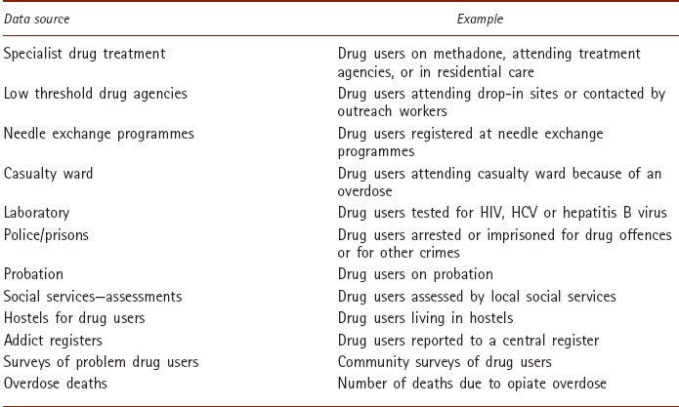
Potential data sources

Slide 10
Example 1
In a survey of MSM taken in street cruising areas, 30 percent say they had a voluntary HIV test in the last year. Data show that 700 of the clients seeking HIV tests in the last year gave male-male sex as a risk factor. Number of MSM?

Slide 11
Question to discuss
But what if VCT is only available to those with health insurance, and gay men with health insurance are wealthier, more likely to be employed in the corporate sector, and less likely than gay men with no health insurance to hang out in street cruising areas?
Notes:
In that case, the men who are represented in the institutional data are not likely to be included in the survey. In other words, the two populations do not correspond, and any population estimate made using these two data sources in conjunction is likely to be quite inaccurate.

Slide 12
Several key issues
Clear, consistent definitions between different data Sources
Stability of r & m
Catchment area

Slide 13
Key Issues
Firstly, the population definitions must be clear
Secondly, the time reference period must be clear, and must be the same in both data sources
Thirdly, the age range of the populations to be compared must be similar
Finally, the catchment area for the services or institutions must be clear

Slide 14
Example 2
Forty five percent of respondents say they have been in prison in the last year in a given city. Over the previous year, the prison service in the city has released 1,234 individuals who had been incarcerated on drug-related offences. Estimate would assume that those 1,234 individuals represented 45 percent of drug users in the city, and that the true number of drug users was therefore in the region of 1,234 / 0.45, or around 2,760.

Slide 15
Questions to discuss
Do think the estimate is accurate? Why not?
What is the main assumption behaind such estimation?
Do you think the assumption is likely to be true?

Slide 16
Assumption:" drug user in prison” is synonymous with “prisoner incarcerated on drug charges”.
Many of those may be people who are dealers
Many people who are users and in prison but were imprisoned for other criminal activities
Who started using drugs while in prison, would not be captured

