Slide 1

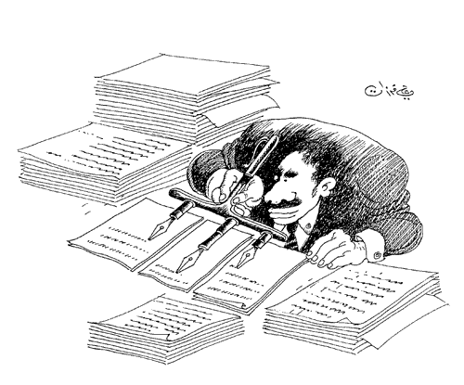
How to write a research paper for publication
بنام او كه آگاه بر هر نهان است و دانا بر هر حقيقت
دانشگاه علوم پزشكي كرمان
علي اكبر حقدوست، اپيدميولوژيست

Slide 2

Why we write?
4
3
1
2
5
6
7
To distribute what we find
To present what we know
To promote
To earn money
To enjoy
To expand mankind knowledge
To ……

Slide 3
Utilization of research findings
آنچه در تحقيقات مي يابيم
يافته هايي كه خود با ارزش مي دانيم
آنچه كه مكتوب مي كنيم
آنچه كه براي چاپ ارسال مي كنيم
آنچه كه به چاپ مي رسانيم
آنچه كه مورد استفاده قرار مي گيرد

Slide 4
Report types
گزارشات آماري
  مقالات تحقيقي
  پايان نامه ها
  گزارشات تحقيقات
  گزارش عملكردها
گزارشات تحليلي (مقالات editorial و بعضي از انواع letters)
گزارشات مروري (مقالات مروري سيستماتيك و متاآناليز)
گزارشات اداري ( از جمله نامه هاي اداري)

Slide 5

Paper and manuscript
Manuscript: scripts that you send to editors
Paper: texts that is published in journals

Slide 6

The main reasons of rejections?
Less than 25% of submitted manuscripts to major scientific journals are accepting, why???
  Inappropriate or incomplete statistics
  Over-interpretation of results
  A sample too small or biased
  Difficult to follow
  Insufficient problem statement
  Inaccuracy or inconsistency of data reported
  Incomplete, inaccurate or outdated review of the literature
  Insufficient data presented
  Defective tables or figures

Slide 7
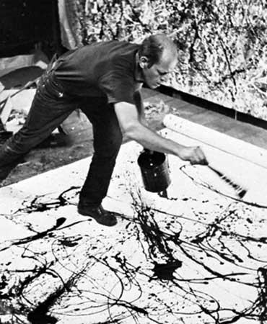
Pay attention
A manuscript should disclose new information or a new way of thinking about old information. If not, it will not be published-regardless of how well it is written

Slide 8
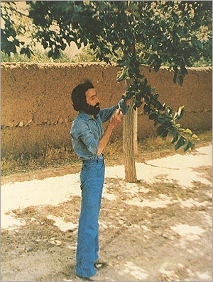
چشم ها را بايد شست، جور ديگر بايد ديد.
واژه ها را بايد شست .
واژه بايد خود باد، واژه بايد خود باران باشد.
چترها را بايد بست.
زير باران بايد رفت.
فكر را، خاطره را، زير باران بايد برد.

Slide 9
Anatomy of a research paper
Less that 500 words
5-6 pp
7-10pp
8-12pp
10-14pp
Between 5 and 20 ones
Abstract
Introduction
Method & Material
Results
Discussion / conclusion
references

Slide 10


Slide 11

Introduction (1)
Concisely describes the study hypothesis, rational, purpose, and objectives

Slide 12
Introduction (2)
Background: three to four paragraphs
  Select key references and remember that for publishing purposes, less in better than more
  Show why your research is important

Slide 13
Introduction (3)
Research question
The last paragraph of the introduction should states the research question as clear as possible

Slide 14
Introduction (4)
Things to avoid in the introduction
  Reviewing the literature extensively
  Arguing against other’s results
  Unrelated paragraphs
  Discussion about controversies
  Speculation

Slide 15
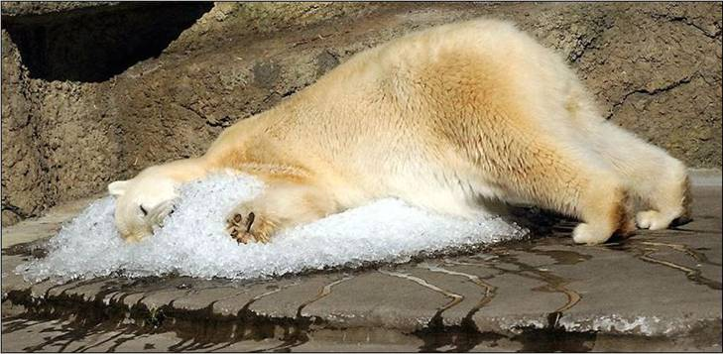

Slide 16
Material and methods (1)
Materials refers to what was examined; e.g., humans, animals, tissues; also to various treatments; e.g., drugs, gases; and instruments
Methods refers to how subjects or objects were manipulated to address the experimental question; how measurements and calculations were made; and how the data were analyzed

Slide 17
Material and methods (2)
Detailed enough so that if some one wants to repeat the study, it will possible.
It shows how much is valid your results

Slide 18
Material and methods (3)
Pay more attention to the main considerations of your research according to your study type

Slide 19
Material and methods (4)
Subject selection criteria
Validity of research tools
preparations
Protocol design including blinding
Controlling biases
Sample size or power estimation
Ethical considerations
Measurements and calculations
Statistical analysis appropriate to study design

Slide 20
Material and methods (5)
Use active voice and
simple past tense

Slide 21


Slide 22
Results (1)
Use active voice and
simple past tense

Slide 23
Results (2)
Describe your sample
Address to your main research question
  Simple statistical tests
  Multivariate analysis
Subset analysis
Accidental findings???

Slide 24
Results (3)
Write a story to show what you find
Do not write:
  Table 1 summarizes our findings in subgroup C
Use advance statistical tests, but show the results as simple as you can
Keep in your mind that most of readers are not familiar with statistical issues, but your papers is checked by reviewers who are expert in statistics !!!

Slide 25
Results (4)
P-value versus confidence interval
Standard deviation versus standard error
Percents versus number

Slide 26
Results (5)
How to write numbers in text?
  Spell out numbers less that 11
  Avoid a sentence starting with a number; in any case, spell out the number
  Be consistence when you write a few numbers in a sentence
  Generally speaking do not put more than two decimal points

Slide 27
Results (6)
Avoiding long and confusing sentences
A third person riding late on an airplane can take your manuscript and get the message at first reading.

Slide 28
Results (7)
Graphs and tables
Simple
Appropriate
Self explanatory
Focus on the main study question
Avoid from repeated characters or phrases
Add statistical information as much as you can

Slide 29
Results (8)
Provide data relevant to the research question

Slide 30

Discussion

Slide 31
Discussion (1)
Elements to include in the discussion
  State the study’s major findings
  Explain the meaning and importance of the finding
  Relate the findings to those of similar studies
  Consider alternative explanations of the findings
  State the clinical relevance of the findings
  Acknowledge the study’s limitations
  Make suggestions for further research
  Take home message

Slide 32
Discussion (2)
Things to avoid in the discussion
  Over presentation of the results
  Unwarranted speculation
  Inflation of the importance of the findings
  Tangential issues
  The “bully pulpit”
  Conclusions that are not supported by the data

Slide 33
Discussion (3)
It should start with:
“Our study showed……”
To lucidly summarize your study findings

Slide 34
Discussion (4)
The second part (2-4 paragraph) may describe the novelty of your findings or if they parallel previous research.
Only beginners try to refer to all published papers in the field.

Slide 35
Discussion (5)
The third part (2-3 paragraphs) may describe how study contradicts previous research or established dogmas

Slide 36
Discussion (6)
The fourth part (1-2 paragraphs) should describe study limitations. It may also mention unsolved questions and direction of further studies

Slide 37
Discussion (7)
The last paragraph is conclusion summarizing the potential significant of your finding and what changes to research or clinical practice your data may support
Avoid broad claims and strong statements.

Slide 38
Discussion (8)
Do not repeat introduction
Do not present new data
Do not repeat data presentation
Avoid general statements that are not founded in data
Do not write a review of all possible mechanisms that you have not accounted for your study

Slide 39
نگو حقيقت را يافتم
بگو حقيقتي را يافتم
جبران خليل
To prove that something is true
or
to find out whether it is true

Slide 40
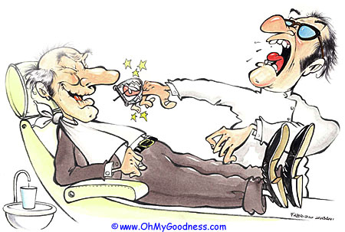

Slide 41
Abstract (1)
Abstract
Versus
summary

Slide 42
Abstract (2)
There are differences between paper abstracts and seminar abstracts

Slide 43
Abstract (3)
Why did you start?
What did you do?
What did you find?
What does it mean?

Slide 44

Abstract (4)
An abstract can be only a “bare bones” version of all the information pertaining to the study; but it should taste “meat” especially in the method and results sections!

Slide 45
Abstract (5)
10 minute talk, I can give it next week
30 minute talk, I can give it tomorrow
1 hour talk, I can give it now
Thomas L Petty

Slide 46
Abstract (6)
Title
Ideally about 10-12 words long, including the scope of the investigation, the study design, and the goad
Do not include jargon phrases such as:
“A study of …..”; or “An investigation into…..”

Slide 47
Abstract (7)
Some writing tips
All acronyms should be spelled out on first use
Use simple declarative sentences
Active voice is preferable
Use generic names for drugs and devices

Slide 48
Publish
Or
perish

Slide 49


