Slide 1

Epidemic Investigation
Ali-Akbar Haghdoost, MD, PhD
Kerman University of Medical Education
January 2008

Slide 2
Definition
Detecting an epidemic in the earliest stage, assessing its determinants, implementing efficient controls, and recommending preventive measures for future

Slide 3
Definition
Detecting an epidemic in the earliest stage, assessing its determinants, implementing efficient controls, and recommending preventive measures for future

Slide 4
Domains
Infectious diseases
Non-infectious diseases
  Nutritional disorders
  Cancers
  Cardio-vascular diseases
  Genetic disorders
  Mental health disorders
  Addiction
  ………..

Slide 5
What is an outbreak?
Unexpected surge in morbidity and/or mortality due to a specific cause
But it is not complete….
Look at the age and sex specific distributions
Look at the pattern of the disease
…….

Slide 6
Incubation Period in infectious diseases
Interval from receipt of infection to the time of onset of clinical illness (signs & symptoms)
Different diseases have different incubation periods
No precise incubation period
  A range is characteristic for a disease
What accounts for this delay?
  Time needed for the pathogen to replicate to the “critical mass” necessary for clinical disease
  Site in the body at which the pathogen replicates
  Dose of the infectious agent received at time of infection
Notes:
A critical variable in investigating an outbreak or epidemic

Slide 7
Disease Outbreaks
Typically, sudden and rapid increase in the number of cases of a disease in a population
Common Source
  Cases are limited to those who share a common exposure
    Foodborne, water
Propagated
  Disease often passed from one individual to another
    Measles, STDs

Slide 8
Essential Steps in an Outbreak Investigation

Slide 9
Steps of an Outbreak Investigation
1) Establish the existence of an outbreak
2) Verify the diagnosis
3) Define and identify cases
4) Describe and orient the data in terms of person, place and time
5) Develop hypotheses
6) Evaluate hypotheses
7) Refine hypotheses and carry out additional studies
8) Implement control and prevention measures
9) Communicate findings
Notes:
These are the 10 basic tasks involved in an acute disease outbreak setting, presented in logical order.
However, depending on the circumstances, you may be performing several of these tasks simultaneously or in different order during the course of the investigation

Slide 10
Step 1: Establish the existence of an outbreak
Before you decide whether an outbreak exists, you must first determine the expected or usual number of cases for the given area and time

Slide 11
Step 1: Establish the existence of an outbreak
Data Sources:
  1) Health department surveillance records for a notifiable disease
  2) Sources such as hospital discharge records, mortality records and cancer or birth defect registries for other diseases and conditions
  3) If local data is not available, make estimates using data from neighboring states or national data

Slide 12
Notifiable Disease
Disease for which regular, frequent, and timely information regarding individual cases is considered necessary for the prevention and control of disease
Notes:
Newly-emerged pathogen (add to list)
Declining incidence (remove from list)

Slide 13
Step 2: Verify the diagnosis
Two goals in verifying a diagnosis:
  1. Ensure that the problem has been properly diagnosed -- the outbreak really is what it has been reported to be
    Review clinical findings and laboratory results for affected people
    Visit or talk to several of the people who became ill
  2. For outbreaks involving infectious or toxic chemical agents, be certain that the increase in diagnosed cases is not the result of a mistake in the laboratory.

Slide 14
Step 3: Define and identify cases
Establish a case definition - a standard set of criteria for deciding whether a person should be classified as having the disease under study
  In many outbreaks, a working definition of the disease syndrome must be drawn up that will permit the identification and reporting of cases
  As the investigation proceeds and the source, mode of transmission and/or etiologic agent becomes better known, you can modify the working definition

Slide 15
Step 3: Define and identify cases
A case definition includes four components:
  Clinical information about the disease,
  Characteristics about the people who are affected (person),
  Information about the location (place), and
  A specification of time during which the outbreak occurred (time).

Slide 16
Step 3: Define and identify cases
To increase sensitivity & specificity of reporting, we use three classifications of cases that reflect the degree of certainty regarding diagnosis:
1) Confirmed
2) Probable
3) Possible
The case definition is used to actively search for more cases beyond the early cases and the ones that presented themselves.
Confirmed Case
Probable Case
Possible Case
Laboratory
Verification
Clinical
Features
+
+
++
+

Slide 17
Step 3: Define and identify cases
The following information should be collected from every affected person in an outbreak:
1) Identifying information - name, address, phone
2) Demographic information - e.g., age, sex, race, occupation
3) Risk factor information
4) Clinical information
    Verify the case definition has been met for every case
    Date of onset of clinical symptoms to create an epidemic curve

Slide 18
Step 4: Describe and orient the data in terms of time, place and person
Characterizing an outbreak by time, place and person is called descriptive epidemiology.
Descriptive epidemiology is important because:
  You can learn what information is reliable and informative (e.g., similar exposures)
  And what may not be as reliable (e.g., many missing responses to a particular question)
  Provides a comprehensive description of an outbreak by showing its trend over time, its geographic extent (place) and the populations (people) affected by the disease

Slide 19
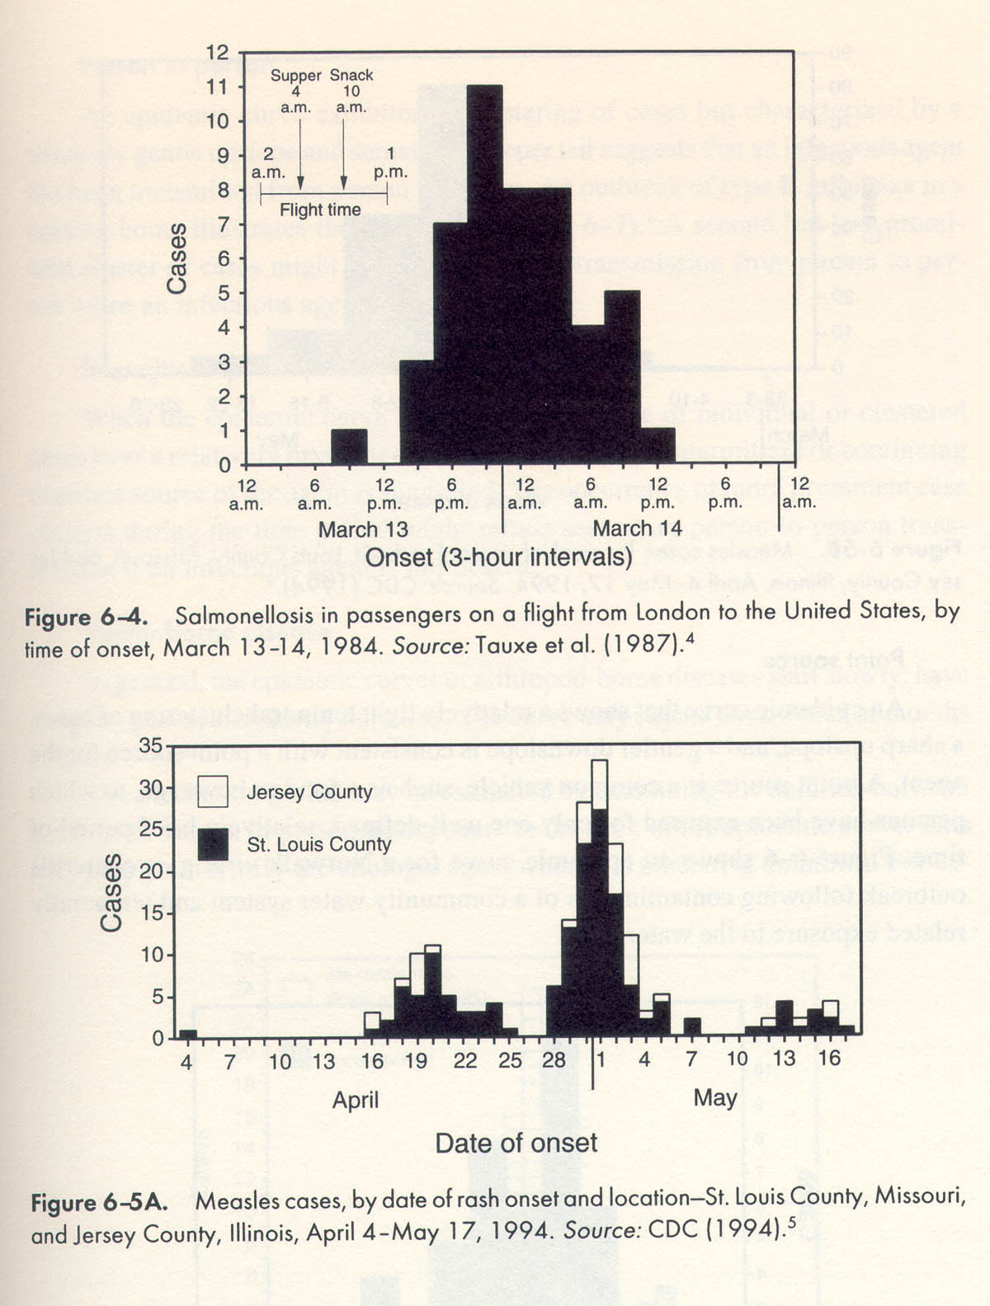
Examples of Epidemic Curves

Slide 21
Step 5: Develop hypotheses
Though we generate hypotheses from the beginning of the outbreak, at this point, the hypotheses are sharpened and more accurately focused.
Use existing knowledge (if any) on the disease, or find analogies to diseases of known etiology
Hypotheses should address
  Source of the agent
  Mode of transmission
  Exposures associated with disease
  and should be proposed in a way that can be tested

Slide 22
Step 6: Evaluate hypotheses
Generally, after a hypothesis is formulated, one should be able to show that:
  1) all additional cases, lab data, and epidemiologic evidence are consistent with the initial hypothesis; and
  2) no other hypothesis fits the data as well
  Observations that add weight to validity:
  The greater the degree of exposure (or higher dosage of the pathogen), the higher the incidence of disease
  Higher incidence of disease in the presence of one risk factor relative to another factor

Slide 23
An exercise: prediction the source of an unknown disease
The severity of the disease varies from minimal symptoms and physical findings up to and including death
The duration of clinical recognizable disease varies from a few weeks to several months
It is associated with poor and unsanitary living condition
It has localized geographical distribution and multiple cases within families were reported
What is the etiology of the disease?

Slide 24
Problem solving, fill the table
nutritional | intoxication | Hereditary | Infection
 |  |  |  | Familiar aggregation
 |  |  |  | Socioeconomic
 |  |  |  | Spatial distribution
 |  |  |  | Symptomatic phase
 |  |  |  | Severity of the disease
 |  |  |  | Age distribution of cases
 |  |  |  | Sex distribution of cases
 |  |  |  | Seasonality
 |  |  |  | others

Slide 25
The results of survey in 24 villages in one year
Number of villages faced by the outbreak classified by the peak date
May 4
May-June 3
June 16
July 1
Oct-Feb 0

Slide 26
Typhoid fever | The disease | Sanitary rating
7.4 | 48.6 | Less than 40
2.6 | 35.6 | 40-69
1.7 | 51.3 | 70 and over
Risk Per 1000 | Month
0 | Jan
0.2 | Feb
1.2 | Mar
5.5 | Apr
13.7 | May
19.7 | June
6.8 | July
2.5 | Aug
1.3 | Sep
0.6 | Oct
0 | Nov
0 | Dec
50.6 | Total
Risk per 1000 | Weekly family income ($)
124.4 | >2.5
83.1 | 2.5-4
53.4 | 4-6
35.5 | 6-8
23.8 | 8-10
12.6 | 10-12
2.6 | >12

Slide 27
Safe water | Disposal | Risk/1000 | Village number
60 | 29 | 49 | 1
54 | 20 | 84 | 2
39 | 0 | 40 | 3
51 | 0 | 33 | 4
95 | 99 | 48 | 5
45 | 50 | 53 | 6
73 | 0 | 48 | 7
90 | 100 | 35 | 8
65 | 56 | 20 | 9
49 | 0 | 101 | 10
80 | 52 | 36 | 11
80 | 78 | 25 | 12
75 | 0 | 66 | 13
60 | 60 | 34 | 14
90 | 2 | 55 | 15
84 | 78 | 70 | 16
90 | 100 | 88 | 17
77 | 15 | 25 | 18
60 | 71 | 40 | 19
85 | 85 | 45 | 20
68 | 11 | 44 | 21
46 | 60 | 59 | 22
45 | 10 | 35 | 23
47 | - | 58 | 24

Slide 29

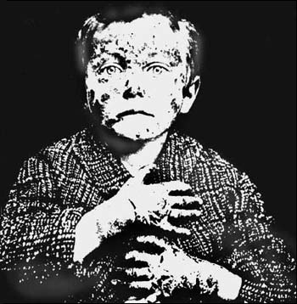
Goldberger in 1921
deficiency of Nicotinic acid
3 Ds:
  Dementia,
  Diarrhea,
  Dermatitis
http://www.history.nih.gov/exhibits/Goldberger/index.html

Slide 30
Identifying the Source of an Outbreak
Look for an item with:
  A high attack rate among those exposed AND
  A low attack rate among those not exposed (so the ratio of attack rates for the two groups is high)
  Ideally, most of the people who became ill should have been exposed to the proposed agent so that the exposure could explain most, if not all, of the cases.

Slide 31
Step 7: Refine hypotheses and carry out additional studies
Additional epidemiologic studies
  What questions remain unanswered about the disease?
  What kind of study used in a particular setting would answer these questions?
  When analytic studies do not confirm the hypotheses
    reconsider the original hypotheses
    look for new vehicles or modes of transmission

Slide 32
Step 7: Refine hypotheses and carry out additional studies
Laboratory and environmental studies
  Epidemiologic studies can
    Implicate the source of infection, and
    Guide appropriate public health action
  But sometimes laboratory evidence can “clinch” the findings
  Environmental studies often help explain why an outbreak occurred and may be very important in certain settings

Slide 33
Case-Control Methods
Applied to a Food-borne Outbreak
The usual approach is to apply the case-control methodology to determine what exposures ill people had that well people did not have:
  List all of the relevant items on the menu
  Determine the proportions of ill and of non-ill persons who ate each of the items by questionnaire
  Identify the food item with the largest difference in attack rates between cases (ill) and controls (non-ill)
Usually one food item stands out as showing the greatest difference in proportion between cases and controls.

Slide 34
Step 8: Implementing control and prevention measures
The practical objectives of an epidemic investigation are to:
  Stop the current epidemic, and
  Establish measures that would prevent similar outbreaks in the future.
Preliminary control measures should be done as soon as possible!
Notes:
The underlying purposes of all epidemic investigations are to control and/or prevent further disease.
So, even though this is listed as Step 9,

Slide 35
Thee outbreaks within one
Every outbreak is really three outbreaks
  Outbreak of cases
  Outbreak of fear
  Outbreak of meeting

