Slide 1

برنامه های مدیریت بیماریهای غیر واگیر در انگلستان و نقش دانشگاهها در آن تحلیل نقش دانشکده بهداشت دانشگاه لندن به عنوان یک مدل
بنام او كه آگاه بر هر نهان است و دانا بر هر حقيقت
دانشگاه علوم پزشكي كرمان
علي اكبر حقدوست، اپيدميولوژيست

Slide 2
در این اسلایدها شما با موارد زیر آشنا خواهید شد
ساختارمدیریت کلان سلامت در انگلستان
شیوه ارتباط ساختار کلان سلامت انگلستان با دانشگاهها
ساختار مدیریت دانشکده بهداشت لندن
شیوه ارتباط دانشکده بهداشت لندن با مدیریت سلامت کشور
نقش ساختارهای علمی غیر دانشگاهی در پر نمودن خلاها

Slide 3
نظام مدیریت سلامت انگلستان
Secretary of state for health
Department of Health
Planning, supervision, coordination and monitoring and evaluation
Local authorities supervising health activities
National Health System
Coordination with Primer mister and Parliament
Strategic health authorities
Primary health services
Secondary health services
NHS Trusts

Slide 4
وضعیت سلامت در انگلستان
Population (2009): 61,113,205
GDP per capita (2008): $36,600
Life Expectancy (years): M 78, F 82
Physicians per 10,000 people (2000-2009): 21
Government health expenditures as percent of total government expenditures (2007): 15.6% (8.4% GDP)
Single health care system: National Health Service (NHS) provides universal care to residents.
National Health Departments determine policy and budget for each country

Slide 5
وضعیت سلامت در انگلستان
Primary care free at point of use, including preventive care, mental health, and hospitals
Cost-sharing for few services (dental and prescription drugs); children, elderly, pregnant, people with disability or certain medical conditions, and low-income are exempt from any co-payments
11.5% purchase supplemental private insurance, largely to avoid wait times, have higher standard of comfort, and choose their specialist.
NHS funded largely by general taxation (76%); out of pocket: 12%
Recently new agencies established to improve quality and responsiveness of the NHS

Slide 6
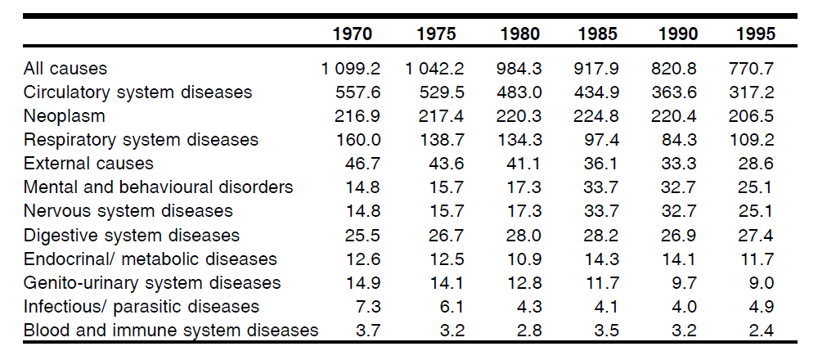
وضعیت مرگ و میر در 100هزار نفر جمعیت در انگلستان
In 2002, the all cause mortality was dropped to 599 per 100,000, and due to Ischemic Hearth Diseases to 120

Slide 7
ساختار مدیریت سلامت در انگلستان
Department of health (DH) was established in 1988 (before that it was department of health and social security). It has responsibility for government policy for English health and social care matters and for the English National Health Service (NHS).
The DH carries out some of its work through arm's length bodies, including non-departmental public bodies and executive agencies such as the Commercial Medicines Unit (CMU) and the Medicines and Healthcare products Regulatory Agency (MHRA).

Slide 8
ساختار مدیریت سلامت در انگلستان
The United Kingdom has a system of generalist, primary care delivered by General Practitioners (GP) based on the location of their residence. GPs have two key roles:
1) to provide primary care
2) to act as gatekeeper for access to specialty care. An individual cannot seek specialty services without a referral from their GP.
However, with only 2.5 practicing physicians per 1,000 population in 2006, a shortage of both primary care physicians and specialists has led to concerns with quality and wait times. (The World Health Organization ranked the United Kingdom 18th in a comparison of health care systems across the world)

Slide 9
ساختار مدیریت سلامت در انگلستان
Most GPs are technically self-employed who provide services to the NHS under contract, so that they are paid directly by local bodies (Primary Care Trusts in England, Primary Care partnerships in Northern Ireland, Health Boards in Scotland and Local Health Boards in Wales) through a combination of methods consisting of salary, capitation and fee-for-service. Private providers set their own fee-for-service rates and are not generally reimbursed by the public system.

Slide 10
ساختار مدیریت سلامت در انگلستان
In recent years, the NHS has focused on improving quality and responsiveness of the health care system.
Two new agencies were set up:
1) the National Institute for Clinical Effectiveness (NICE) for assessing the evidence for the clinical and cost-effectiveness of drugs and medical procedures
2) the Commission for Health Improvement (CHI) for inspecting the performance of NHS institutions

Slide 11
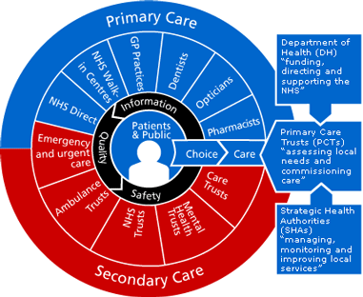
تشکیلات NHS

Slide 12
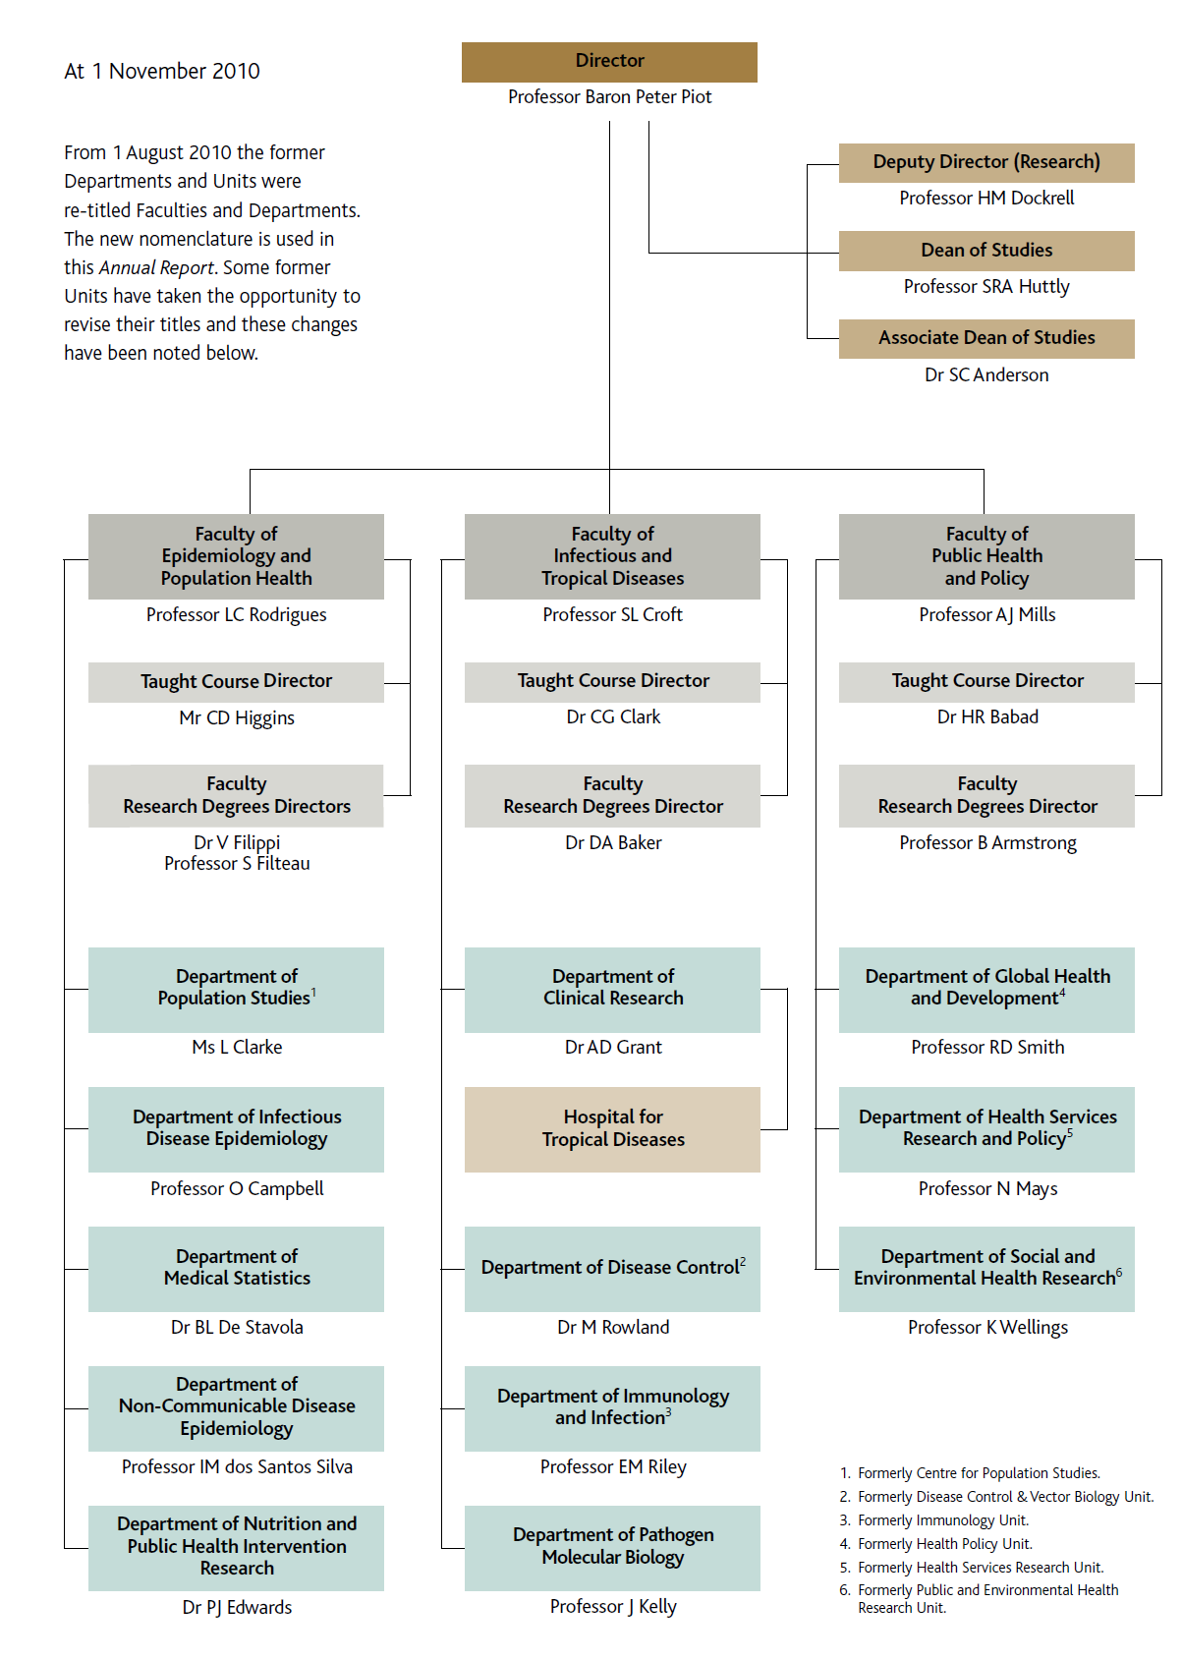
London School of Hygiene and Tropical Medicine (LSHTM)
بزرگترین مرکز آموزش رشته های مرتبط به سلامت در انگلستان با حدود 700 عضو هیئت علمی که در این بین حدود 300 اپیدمیولوژیست و 200 متخصص آمار هستند.
هر سال بیش از 200 دانشجوی کارشناسی ارشد در این دانشکده شروع به تحصیل می کنند.
ارتباطات بین المللی بسیار قوی دارد و در مطالعات کشوری نیز نقش مهمی را بازی می کند.

Slide 13
LSHTM faculties
Epidemiology and Population Health
Infectious and Tropical Diseases
Public Health and Policy

Slide 14
Faculty of Epidemiology and Population Health
Department of Population Studies
Department of Infectious Disease Epidemiology
Department of Medical Statistics
Department of Non-communicable Disease Epidemiology
Department of Nutrition & Public Health Intervention

Slide 15
Department of Non-communicable Disease Epidemiology
Ageing
Alcohol Consumption
Cancer Aetiology and Screening
Cancer Survival
Cardiovascular Disease and Type 2 Diabetes
Centre for Chronic Disease in South Asia
Genetic Epidemiology
Pharmacoepidemiology and Pharmacogenetics
Reproduction, Growth and Development

Slide 16
The Mission Statement
The mission of the School is to contribute to the improvement of health worldwide through the pursuit of excellence in research, postgraduate teaching and advanced training in national and international public health and tropical medicine, and through informing policy and practice in these areas.

Slide 17
Presentation of the Vision
The Vision for the next 10 years focuses on three areas: research, learning and teaching, and engagement. ….

Slide 18
The Vision is underpinned by the School’s key values
i. dedication to reducing inequalities in health and global disease burdens through research and education;
ii. excellence in research, education, and stakeholder engagement, which will be
achieved by attracting and retaining high calibre, committed and diverse staff and students;
iii engagement in the translation of knowledge into health-related policy and practice;
iv strong relationships with partners and other stakeholders, which are based on mutual respect, honesty and openness;
v sharing expertise to support the development of capacity in other research and public health institutions, particularly those in lower income countries;
vi equal opportunities with respect to gender, race, sexuality, age, disability, religion, political affiliation, marital or parental status, and socio-economic background within and through all activities; and
vii commitment to environmental sustainability.

Slide 19
Research vision
The School will continue to enhance its position as a global leader in research, focussing on work of the highest, internationally-competitive standard. Our research will be methodologically rigorous, conceptually innovative, focussed on important scientific questions, responsive to existing and emerging health priorities, influential in the development and implementation of policy and practice, and financially sustainable.

Slide 20
Learning and teaching
The School’s teaching programme of postgraduate taught courses and research degrees will provide education and training of the highest quality for future leaders, practitioners, and researchers in public health and tropical medicine within London, the UK and internationally. Recognising the changing needs of learners, the programme will offer considerable flexibility in study opportunities facilitated by strategic partnerships and the use of appropriate technology.

Slide 21
Engagement
The School will seek to maximise its impact on scientific knowledge and to inform policy and practice in countries at all levels of development. This will be achieved through engagement with research users throughout the research process, maintaining strategic relationships with key stakeholders, and enhancing the School’s communications capacity.

Slide 22
Objectives
E1 To raise awareness of significant public health issues and promote the wider
understanding of, and engagement with, science;
E2 To raise the national and international profile of the School, and our contribution to
public health and the advancement of science
E3 To continue building effective relationships with governments, funders,
implementation agencies, public health professionals, the scientific community and
our alumni which enable the school to maximise our impact on scientific knowledge
and policy and practice;
E4 To develop strategic relationships with policy and practice-related organisations
(including, for example, the Health Protection Agency, National Institute for Health
and Clinical Excellence, UK Royal Colleges, and the World Health Organisation)
which have the potential to increase the impact of the School’s contribution to policy
and practice and to secure the funding to support these;
E5 To encourage and support staff in engaging with research users throughout the
research cycle, so that impact on scientific knowledge and policy and practice is
maximised;
E6 To study the relationship between research, policy, practitioners and the public, and
draw on this knowledge to provide the evidence base for engagement strategies and
to inform the collection of evidence on impact for the REF.

Slide 23
ارتباط بین سیستم سلامت و دانشکده بهداشت لندن
شناسایی مشکلات سلامت
طراحی و اجرای پروژه های تحقیقاتی مورد نیاز سیستم
به روز نمودن مدیریت سیستم سلامت
تربیت نیروهای مورد نیاز
به چالش کشیدن شیوه مدیریت و شناسایی نقاط ضعف
تقویت سیستم علمی و آموزشی
تولید مستندات مناسب آموزشی

Slide 24

معرفی یک موسسه علمی وابسته به NHS
The National Institute for Health and Clinical Excellence (NICE) provides guidance, sets quality standards and manages a national database to improve people's health and prevent and treat ill health.
NICE works with experts from the NHS, local authorities and others in the public, private, voluntary and community sectors - as well as patients and carers. We make independent decisions in an open, transparent way, based on the best available evidence and including input from experts and interested parties.

