Slide 1

Probabilistic Bias Analysis
بنام او كه آگاه بر هر نهان است و دانا بر هر حقيقت
دانشگاه علوم پزشكي كرمان
علي اكبر حقدوست، اپيدميولوژيست

Slide 2
Applications
With probabilistic bias analysis, the investigator specifies probability distributions for each of the bias parameters, and then uses Monte Carlo sampling techniques to generate a frequency distribution of corrected estimates of effect.

Slide 3
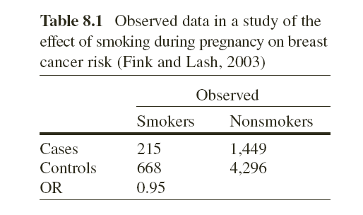
Relationship between smoking during pregnancy and breast cancer
What would be the results if we assume that the sensitivity of our question was 78%?
How much you are sure that the sensitivity is exactly 78%? What would be the results if I assume it ranges between 68% and 88%

Slide 4
Probability distribution
To conduct a probabilistic bias analysis, we need to specify a probability distribution for all or some of the bias parameters
  Discrete probability distribution, which is also called a probability mass function
  Continuous probability distribution, which is also called a probability density function

Slide 5
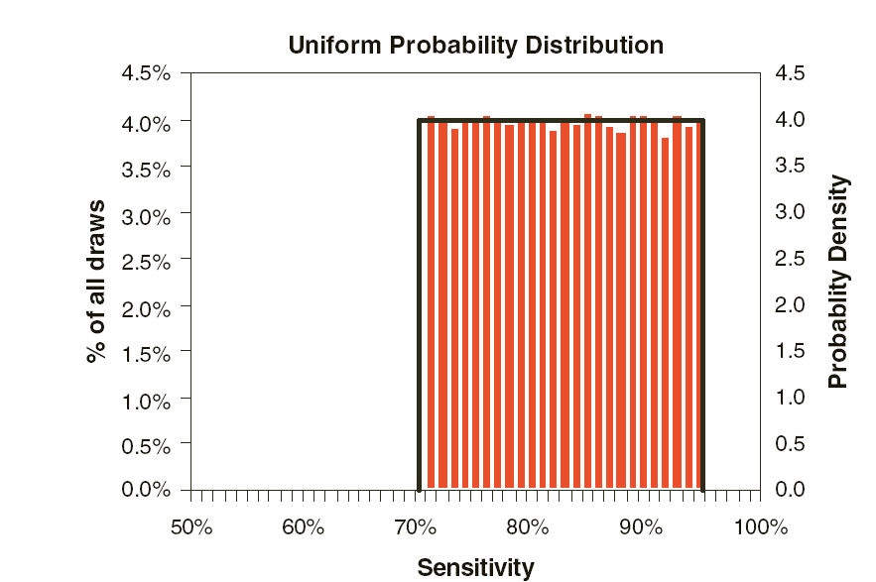
Uniform Distribution
random_{min,max}=min+u·(max-min)

Slide 6
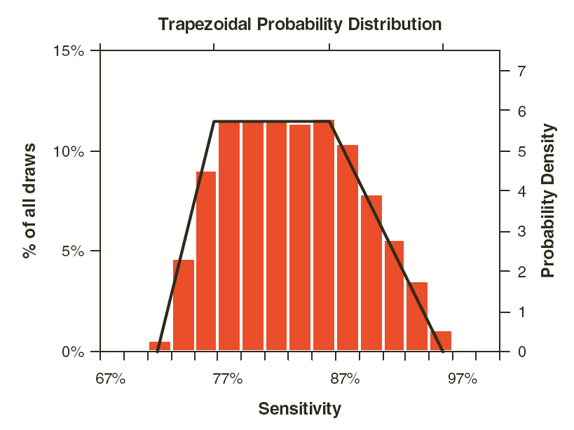
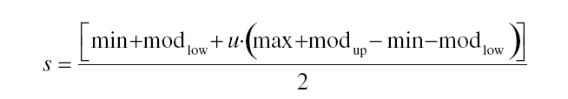
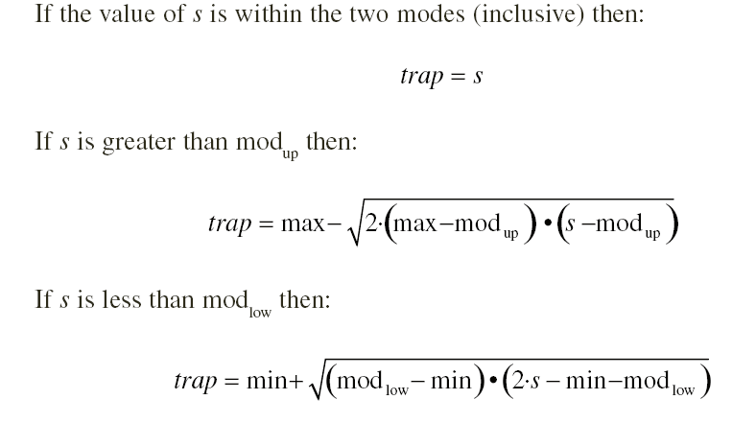
Trapezoidal Distribution

Slide 7
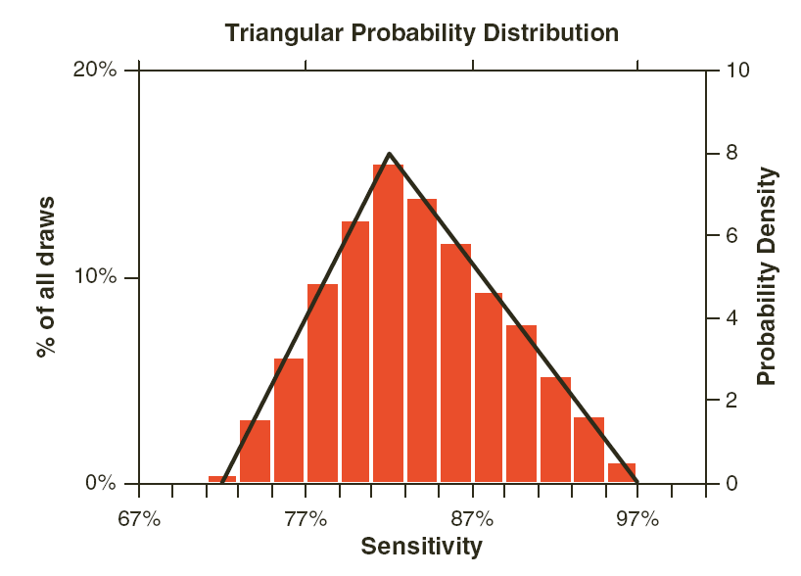
Triangular Distribution

Slide 8
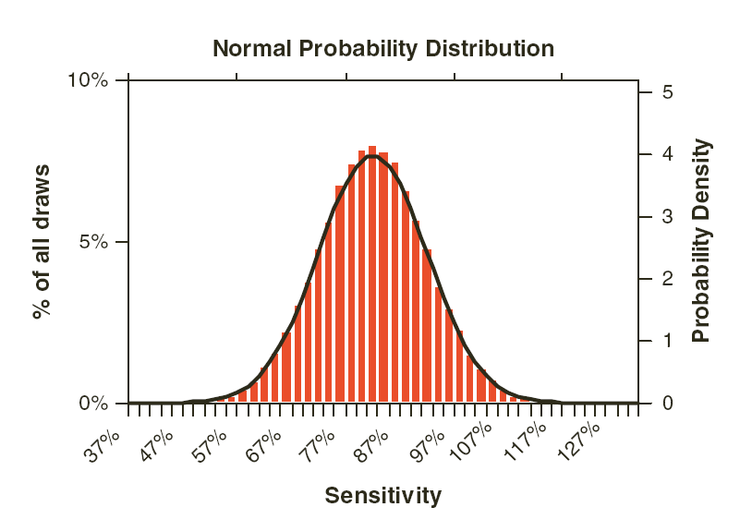

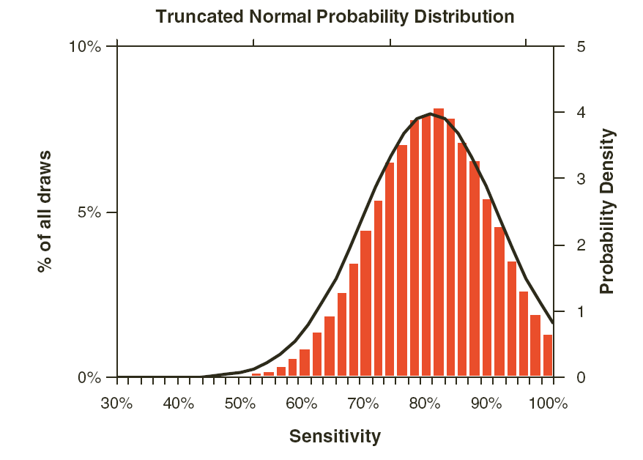
Normal Distribution

Slide 9
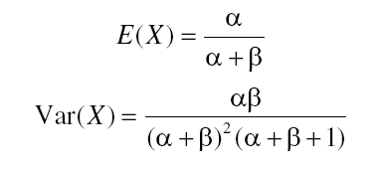
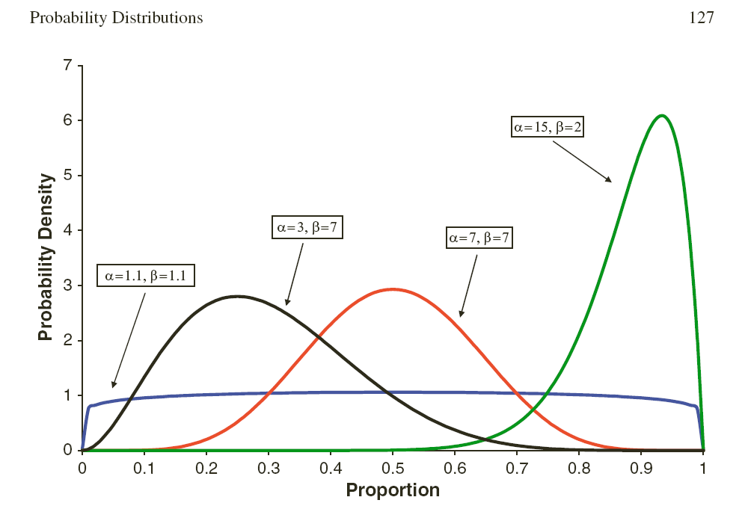
Beta Distribution

Slide 10
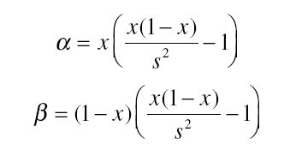
Beta Distribution
an approximate guide for choosing values for Alpha and Beta is to specify a range of likely values with minimum = a and maximum = c , and also a mode = b
The mean of the beta distribution then approximately equals ( a + 4 b + c )/6 and the standard deviation equals ( c − a )/6.

Slide 11
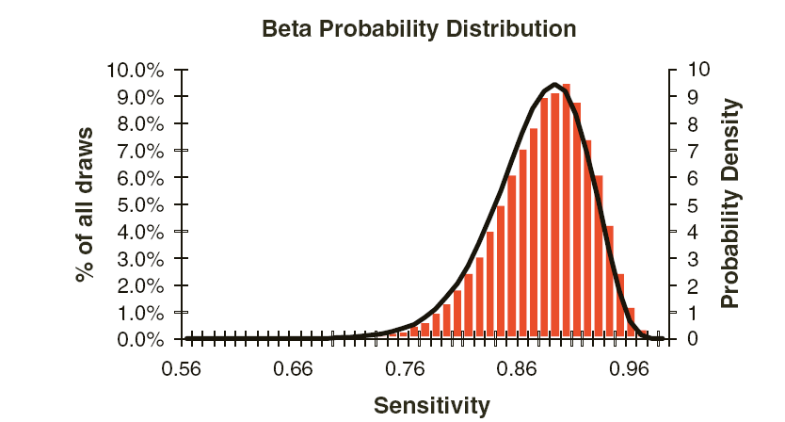
Beta Distribution

Slide 12
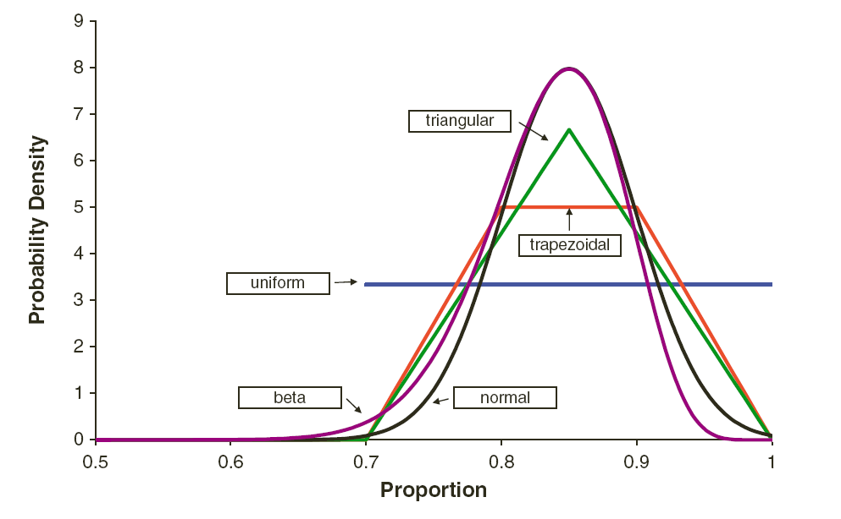
Comparing different distributions

Slide 13
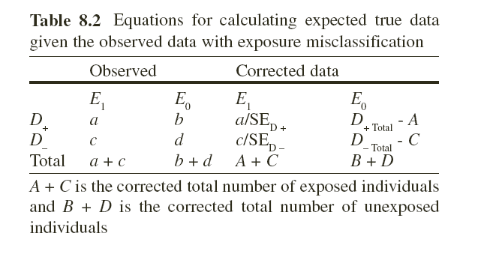
Sensitivity analysis

Slide 14
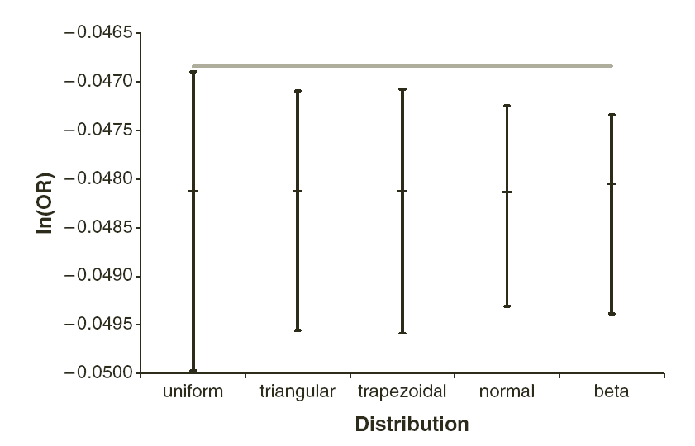
Sensitivity analysis with different distributions

Slide 15
Exposure Misclassification Implementation
sensitivity (SE) of 78%
specificity (SP) of 99%
and for the misclassification to be non-differential

Slide 16
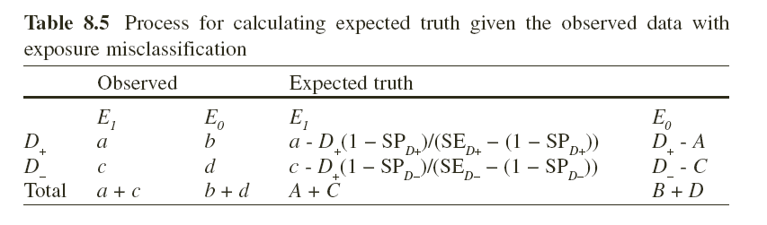
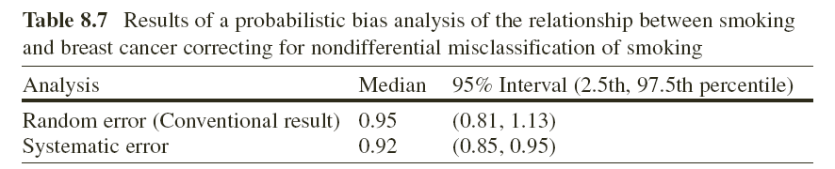
Exposure Misclassification Implementation
uniform distribution for both sensitivity and specificity; we have to multiple two distributions

Slide 17
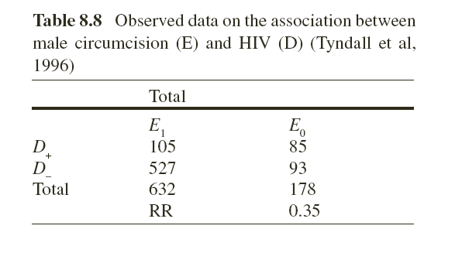
Unmeasured Confounding Implementation
the prevalence of being Muslim vs. any other religion was 80% among circumcised men ( p₁ ) and 5% among uncircumcised men ( p₀ ).
Muslim men had 0.63 times the risk of acquiring HIV as men who did not (RR_{CD} ).

Slide 18
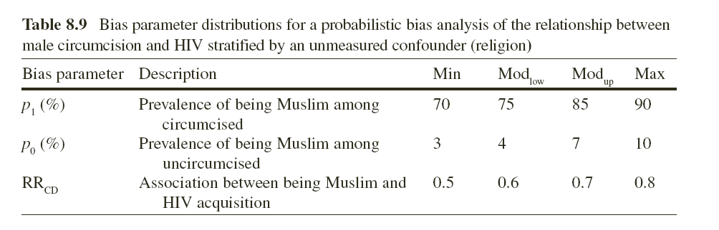

Slide 19
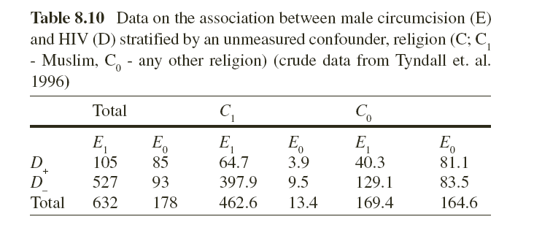
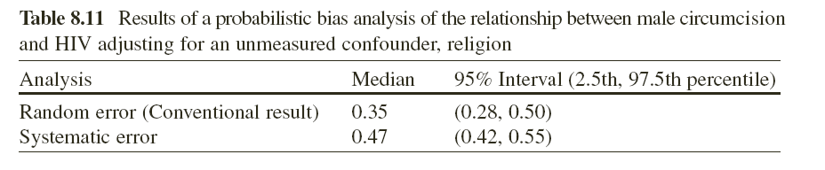

Slide 20
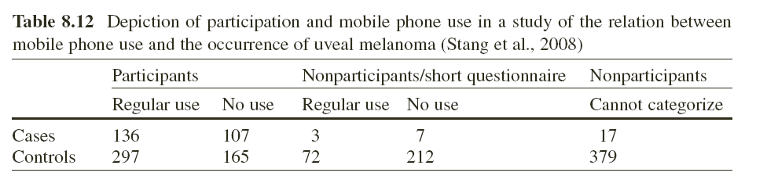
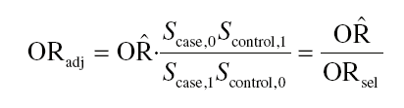
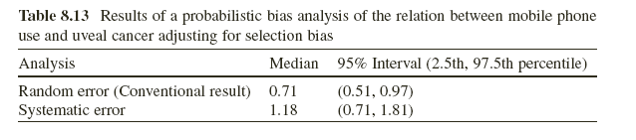
Selection Bias Implementation

Slide 21
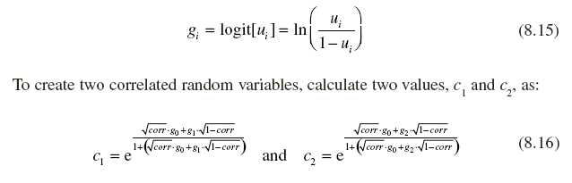
Correlated Distributions

Slide 22
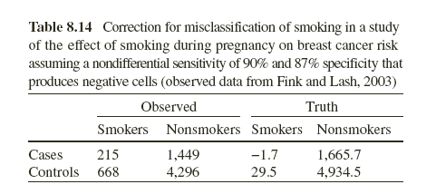
Impossible Values for Bias Parameters

Slide 23

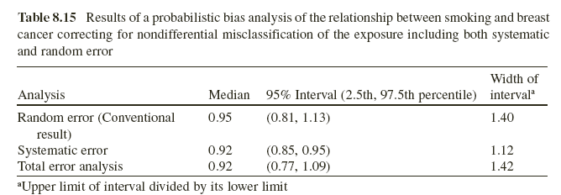
Combining Systematic and Random Error

