Slide 1

نیم رخ شاخصهای کلان سلامت در ایران و منطقه
بنام او كه آگاه بر هر نهان است و دانا بر هر حقيقت
دانشگاه علوم پزشكي كرمان
علي اكبر حقدوست، اپيدميولوژيست

Slide 2
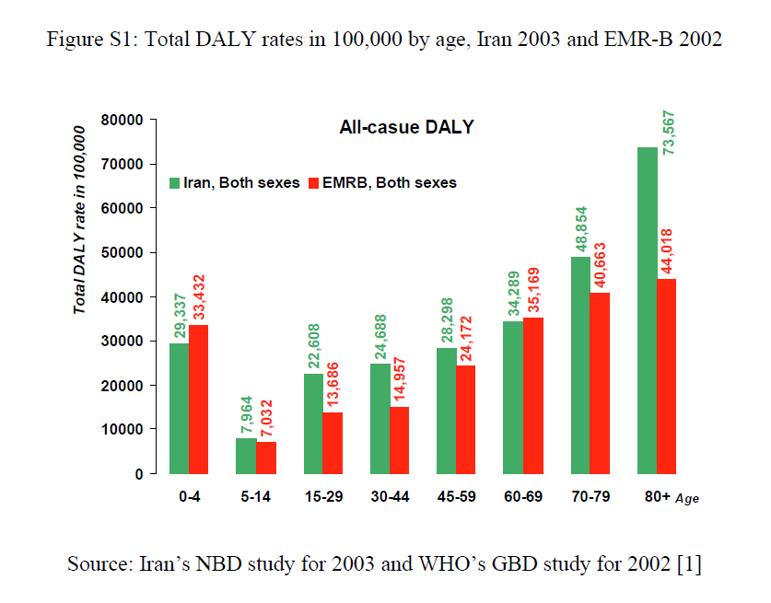
مقایسه بار بیماریهای ایران و سایر کشورهای منطقه مدیترانه شرقی

Slide 3
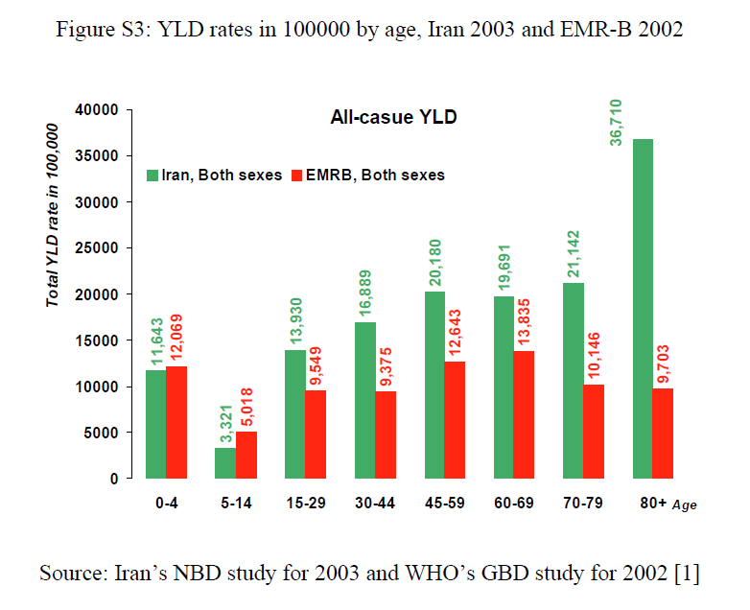
مقایسه بار ناتوانیهای ایران و سایر کشورهای منطقه مدیترانه شرقی

Slide 4
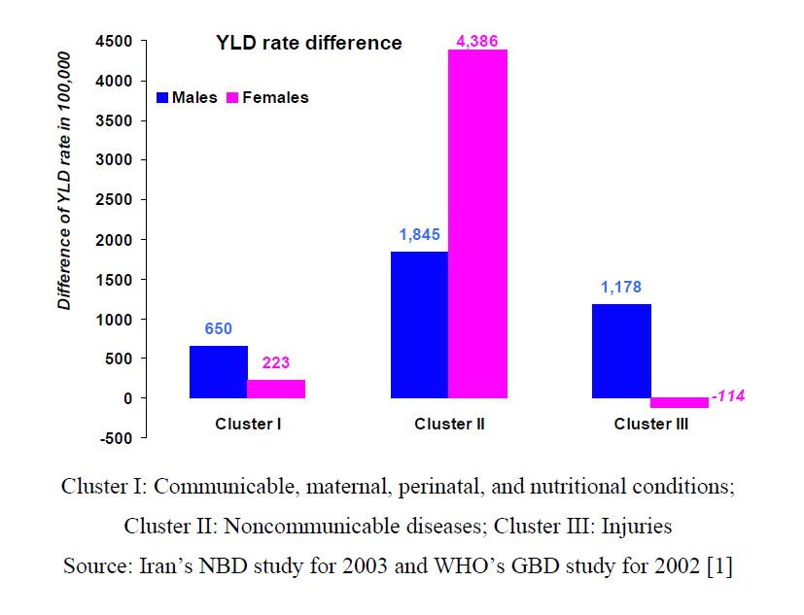

Slide 5
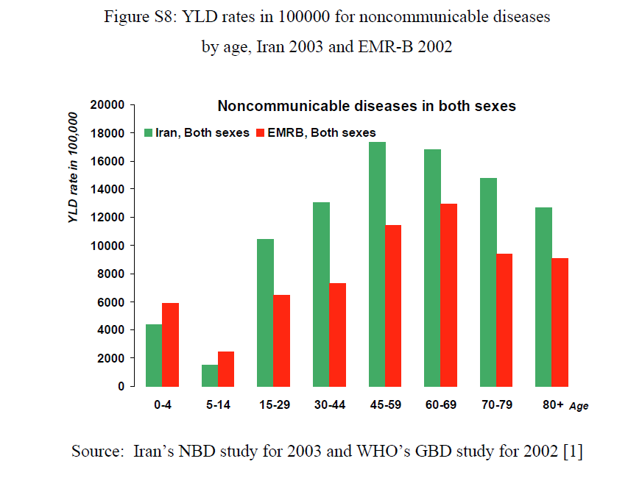

Slide 6
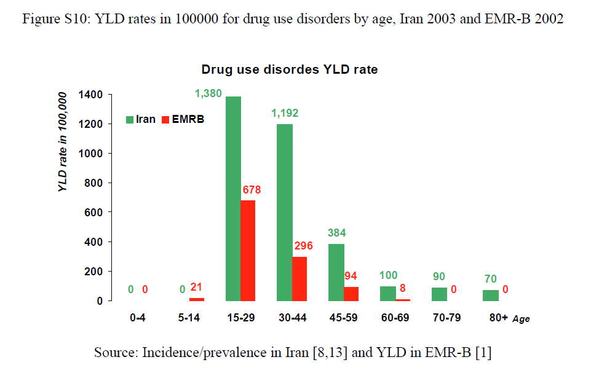

Slide 7
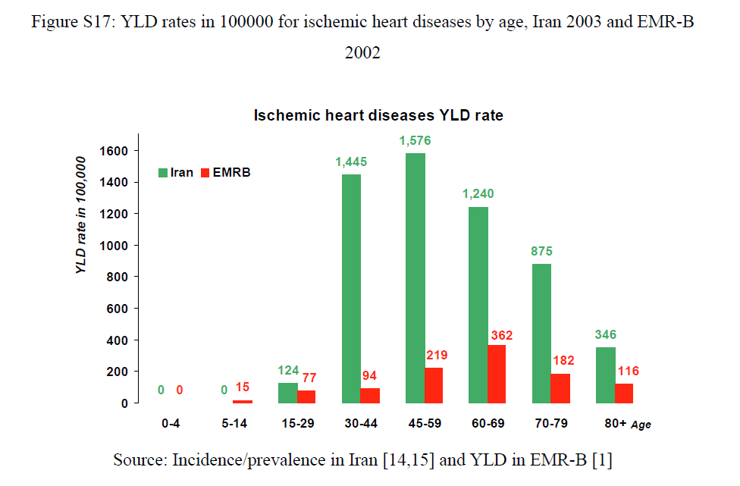

Slide 8
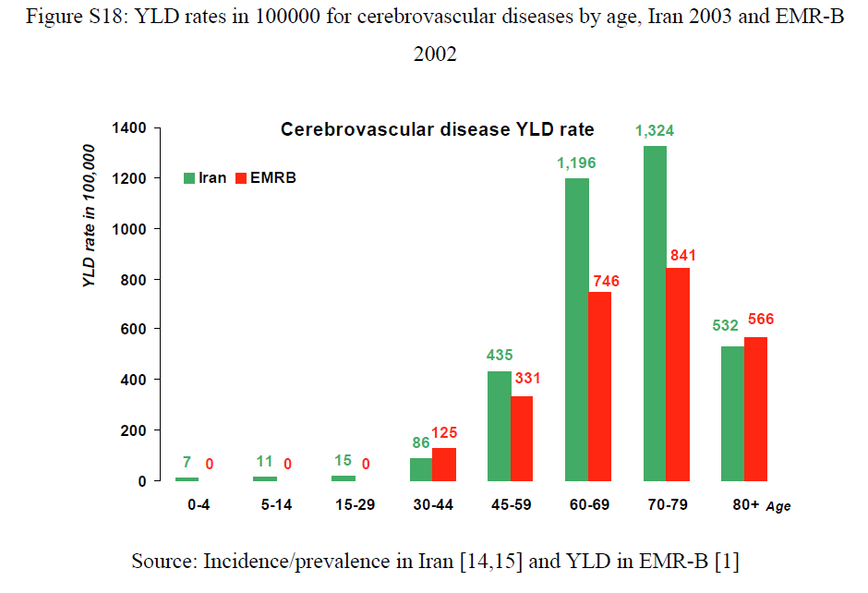

Slide 9
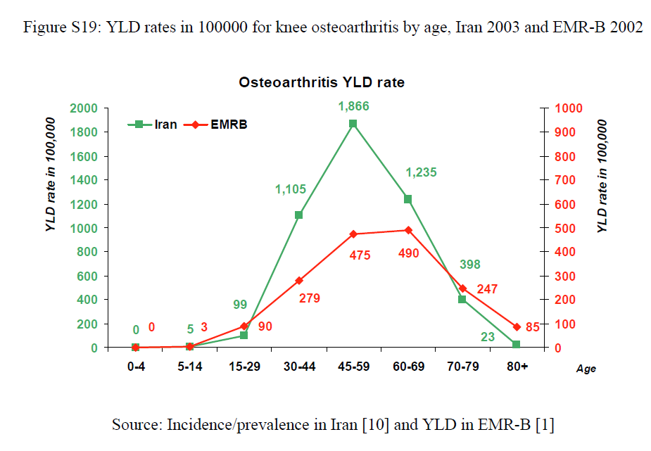

Slide 10
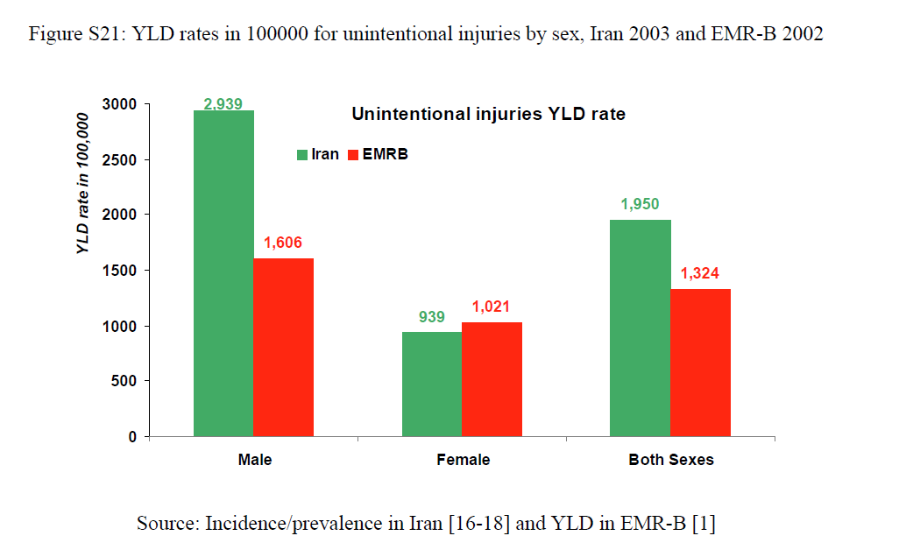

Slide 11
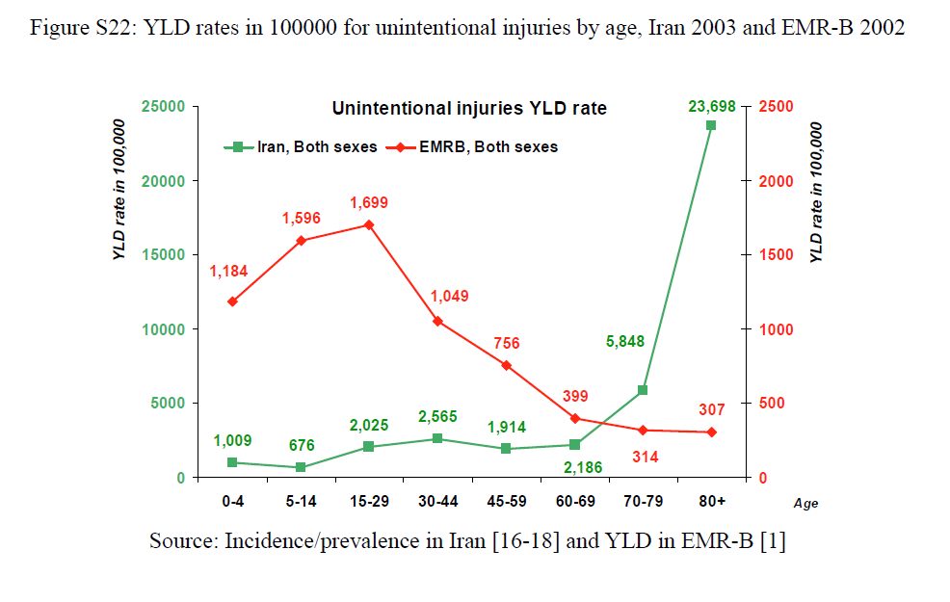

Slide 12
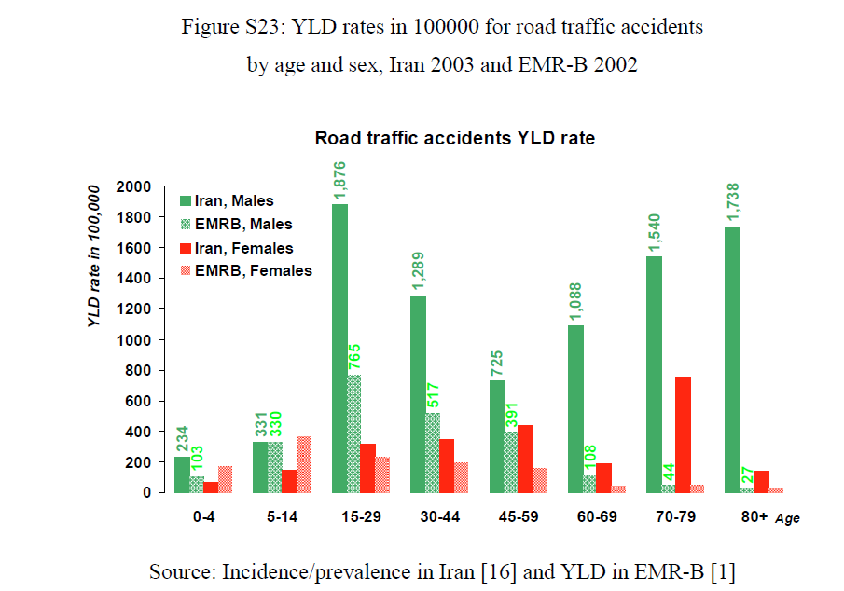

Slide 13
Life expectancy estimation in Iran 1950 - 2050
World Population Prospects (UN, 2005)

Slide 14
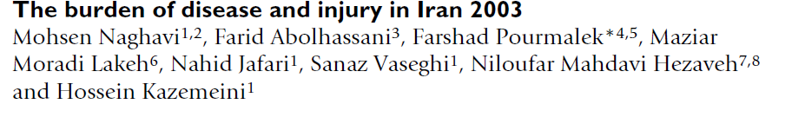
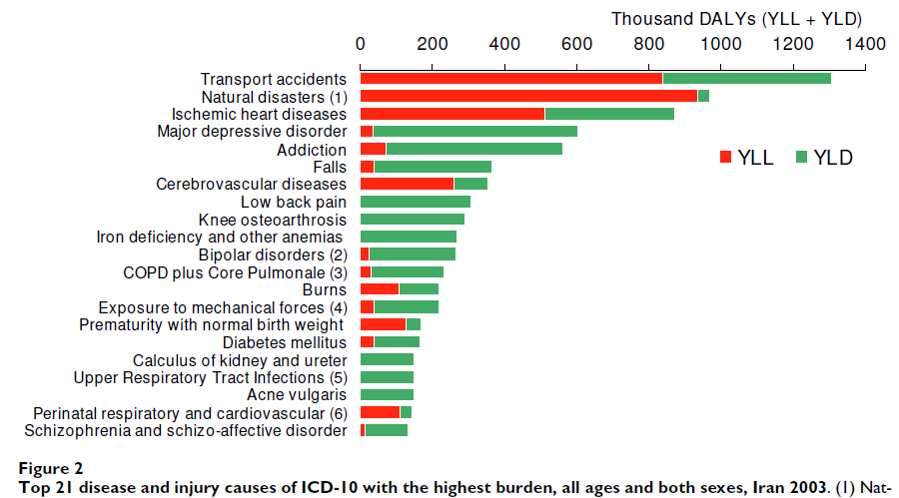

Slide 15
Top ten causes of YLD in Iran, 2003
Rank | ICD entities ranked by YLD rate | YLD rate in 100,000
1 | Depression | 852
2 | Addiction | 735.3
3 | Transport accidents | 703.6
4 | Ischemic heart disease | 538.5
5 | Falls | 486.8
6 | Low back pain | 462.7
7 | Knee osteoarthrosis | 437.9
8 | Anemia (iron deficiency & others) | 403.3
9 | Bipolar disorder | 366.8
10 | COPD† + Cor pulmonale | 305.9

Slide 16
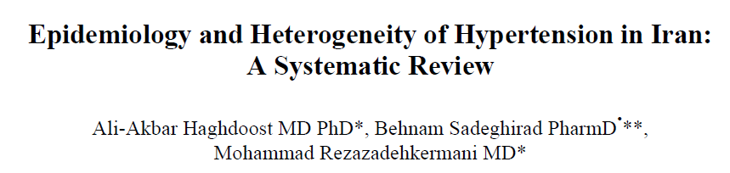
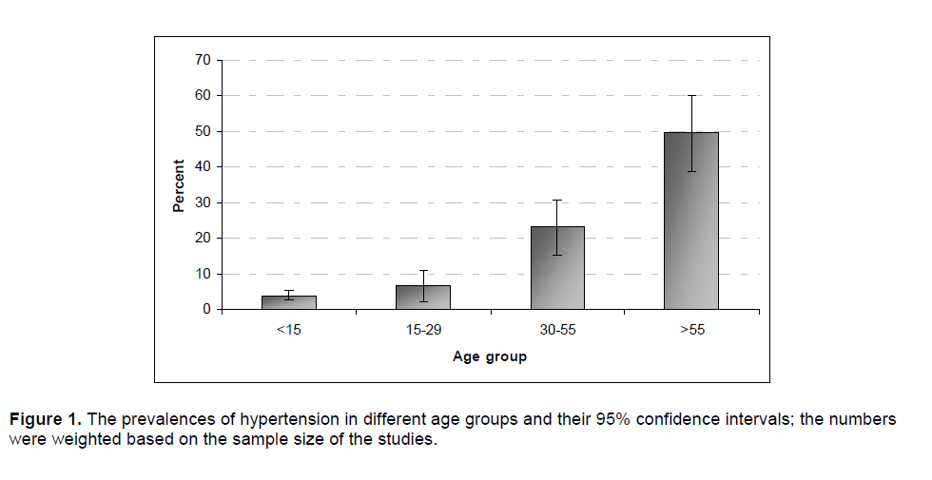

Slide 17
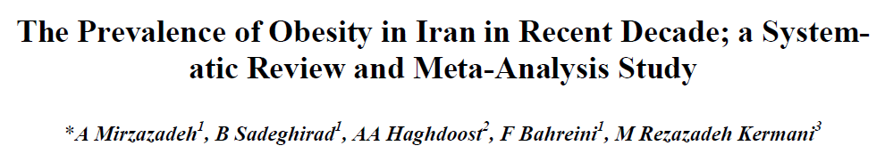
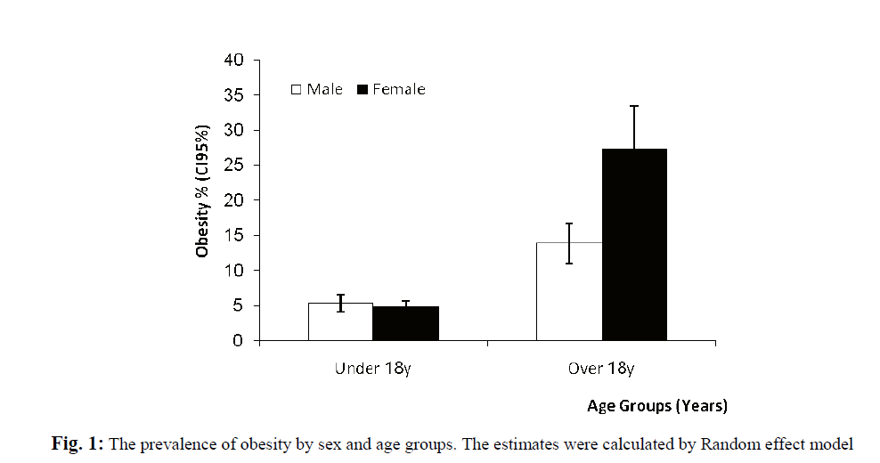

Slide 18
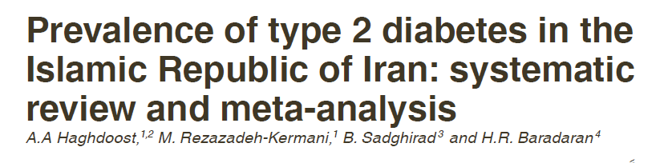
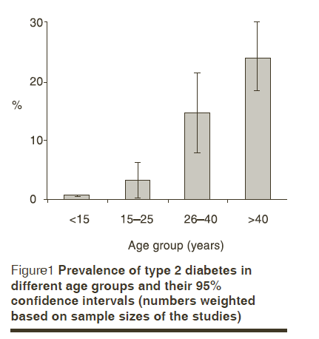

Slide 19
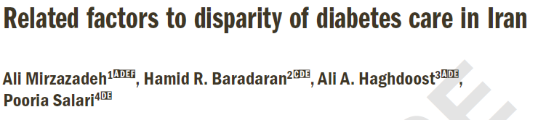
 | Controlled DM (n=1419) | Un-Controlled DM (n=1504) | Crude OR [CI 95%] | Adjusted OR [CI 95%]
Gender (%) Male ¥ Female | 449 (41.12) 808 (44.18) | 643 (58.88) 1021 (55.82) | 1 1.13 [.97-1.32] | 1 1.06 [0.90-1.27]
Age group (%) 25-34 ¥ 35-44 45-54 55-64 | 102 (76.69) 211 (49.76) 391 (40.23) 554 (39.74) | 31 (23.31) 213 (50.24) 581 (59.77) 840 (60.26) | 1 3.32 [2.13-5.18]* 4.89 [3.21-7.46]* 4.99 [3.29-7.56]* | 1 3.21 [2.04-5.06]* 4.98 [3.22-7.69]* 5.29 [3.42-8.18]*
Marital statues (%) Married ¥ Single Other | 1098 (42.71) 40 (50.00) 119 (43.91) | 1473 (57.29) 40 (50.00) 152(56.09) | 1 .75 [.48-1.16] .95 [.74-1.23] | 1 0.94 [0.59-1.51] 0.88 [0.67-1.15]
Living Area (%) Rural ¥ Urban | 381 (51.42) 877 (40.19) | 360 (48.58) 1305 (59.81) | 1 1.57 [1.33-1.86]* | 1 1.39 [1.16-1.67]*
Educational Level (%) Illiterate ¥ Literate | 573 (43.67) 682 (42.44) | 739 (56.33) 925 (57.56) | 1 1.05 [.91-1.22] | 1 1.11 [0.93-1.32]
DM in Family (%) No ¥ Yes | 758 (47.94) 493 (37.01) | 823 (52.06) 839 (62.99) | 1 1.57 [1.35-1.82]* | 1 1.55 [1.33-1.81]*
Obesity (%) Healthy Weight ¥ Over-weight Obesity I Obesity II Obesity III | 307 (44.17) 532 (42.80) 314 (43.43) 84 (41.79) 17 (30.36) | 388 (55.83) 711 (57.20) 409 (56.57) 117 (58.21) 39 (69.64) | 1 1.06 [0.88-1.28] 1.03 [0.84-1.27] 1.10 [0.80-1.51] 1.82 [1.01-3.27]* | 1 1.02 [0.84-1.24] 0.98 [0.79-1.23] 1.09 [0.78-1.52] 1.74 [0.95-3.18]
Uncontrolled DM : FPG>130 with positive history of DM ; ¥ Control Group ; * P value<0.0001

Slide 20
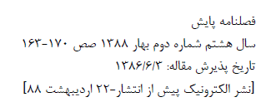
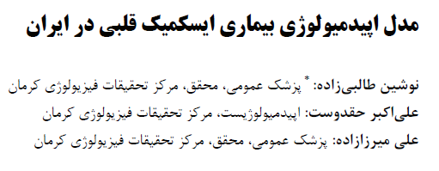
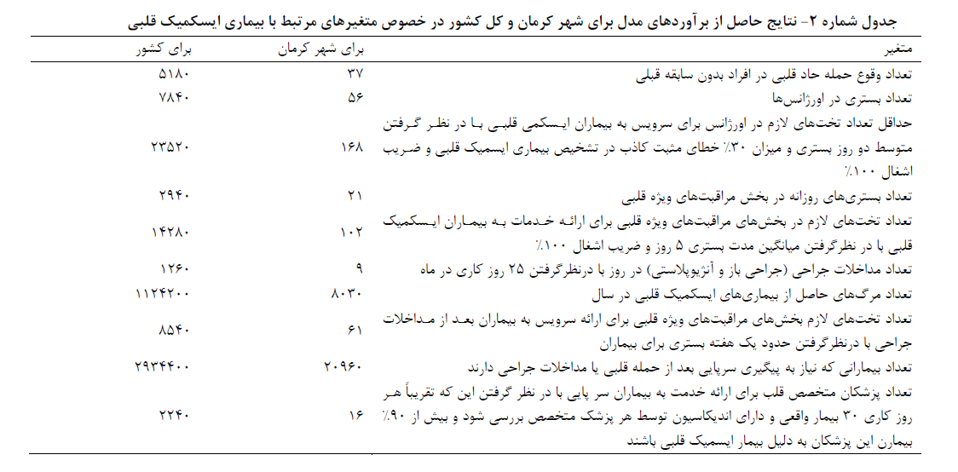

Slide 21
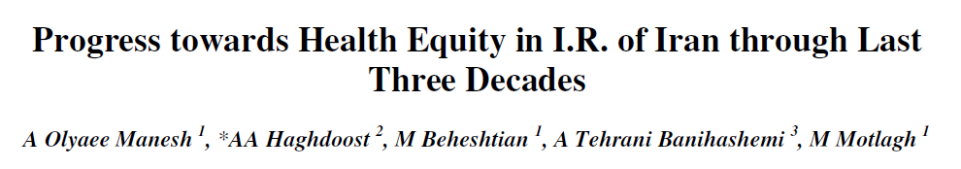
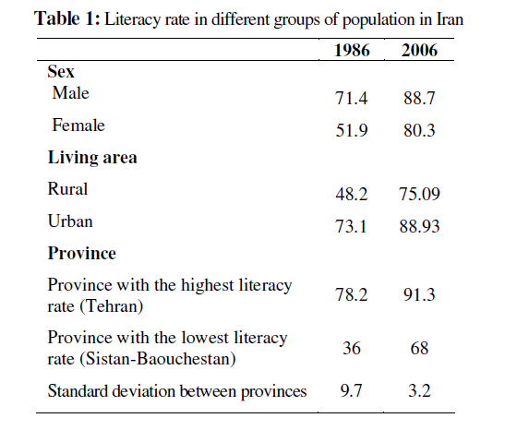

Slide 22
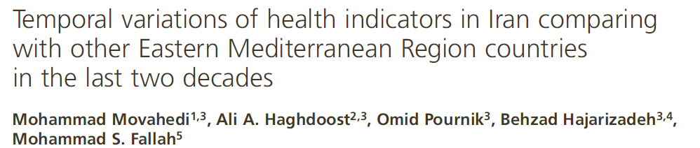
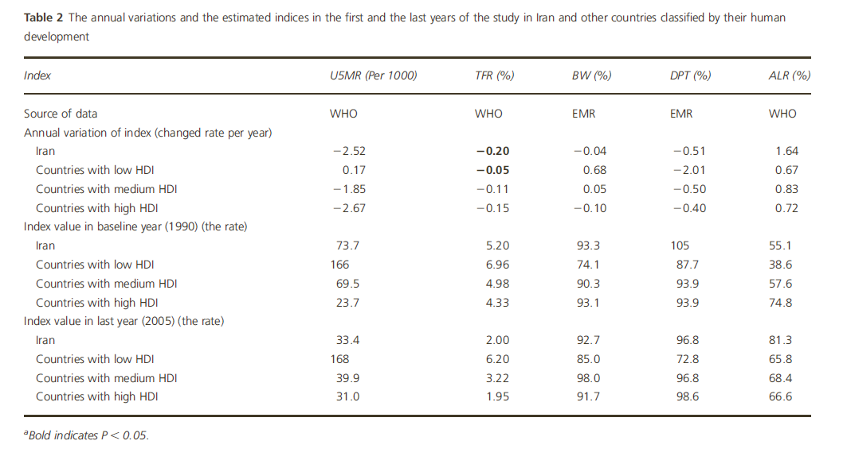

Slide 23
